Slide 1
Cyber Safety: Scams, Catfishing, Subscriptions & Purchasing Safety
Recognising Scams or Fake Profiles
Finding ways to verify legitimate purchases
Managing subscriptions

Slide 2
Today's Discussion Topics
Identifying Scams and Fraudulent Activities Online
Spotting and Avoiding Fake Profiles
Assessing Online Authenticity and Trustworthiness
Safe Practices When Buying/Selling Online
Managing and Monitoring Online Subscriptions

Slide 3
Scamming:
Scamming is the act of deceiving someone to gain money, personal information, or other benefits through dishonest or fraudulent means.
In simple terms, it's tricking someone on purpose to get something from them unfairly, often by pretending to be someone or something they’re not.

Slide 4
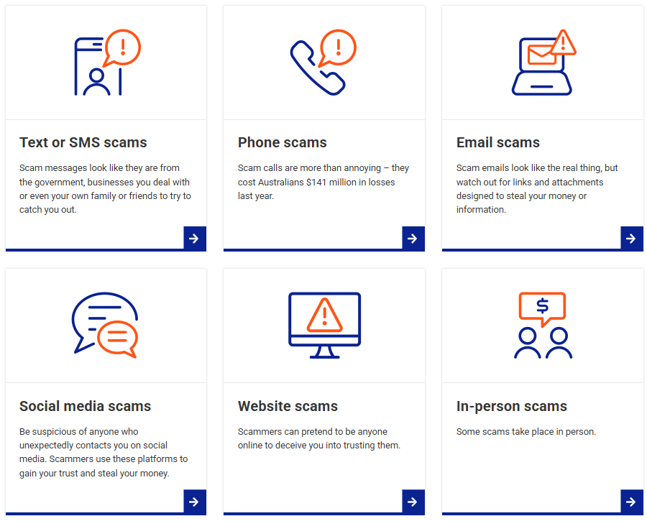
Where can Scams take place?

Slide 5
What types of Scams are there?
Romance Scams
Phishing Scams
Identity Theft
Advanced Fee Scams
Remote Access Scams
Investment Scams
Blackmail Scams
Buying and Selling Scams
Impersonation Scams
Invoice Fraud
Email/Profile Compromise Scams
Employment Scams
Charity Scams
Lottery Scams
Tech Support Scams
Recovery Scams
Notes:
Common scams include:
phishing — an email or text that tries to trick you into providing your personal details
computer virus scams — where you get a phone call saying your computer has been infected with a virus, which the caller can fix, as long as you give them your credit card details and remote access to your computer
investment scams — you’re offered the chance of high returns for very little risk
inheritance or lottery and competition scams — where you’re told you’ve inherited or won money, but you need to pay a fee or taxes before you can get your winnings
online dating scams — where a person you’ve only met online and have become romantically attached to starts asking for money or wants your personal details
door-to-door scams — where someone knocks on your door and offers to do a job for you for an upfront fee, and then does it badly or not at all
phone scams — someone calls pretending to be from a government department or a well-known company, and asks for your personal information
identity theft — people try to find out your personal details and passwords so they can use your details to steal money or set up fake identities.
Taken from https://www.govt.nz/browse/law-crime-and-justice/scams/

Slide 6
What types of Scams are there?
Romance Scams - A scammer builds a fake online relationship and then emotionally manipulates you into sending them money or personal details.
Phishing Scams - Fake messages or links trick you into giving login credentials, credit card info, or other sensitive data.
Identity Theft - A criminal steals your personal information to open accounts, take out loans, or commit fraud in your name.
Advanced Fee Scams - You’re promised a large reward (like a loan or inheritance) but must pay upfront fees or taxes first—which never leads to anything.
Remote Access Scams- You’re tricked into giving a scammer control over your computer, often leading to data theft or financial fraud.
Investment Scams - Fraudsters lure you into fake investment opportunities, promising high returns with little risk, and then disappear with your money.
Blackmail Scams - Scammers threaten to release private or embarrassing information unless you pay a ransom.
Buying and Selling Scams - A scammer poses as a buyer or seller online, sending fake payments or failing to deliver goods after receiving your money.
Notes:
Common scams include:
phishing — an email or text that tries to trick you into providing your personal details
computer virus scams — where you get a phone call saying your computer has been infected with a virus, which the caller can fix, as long as you give them your credit card details and remote access to your computer
investment scams — you’re offered the chance of high returns for very little risk
inheritance or lottery and competition scams — where you’re told you’ve inherited or won money, but you need to pay a fee or taxes before you can get your winnings
online dating scams — where a person you’ve only met online and have become romantically attached to starts asking for money or wants your personal details
door-to-door scams — where someone knocks on your door and offers to do a job for you for an upfront fee, and then does it badly or not at all
phone scams — someone calls pretending to be from a government department or a well-known company, and asks for your personal information
identity theft — people try to find out your personal details and passwords so they can use your details to steal money or set up fake identities.
Taken from https://www.govt.nz/browse/law-crime-and-justice/scams/

Slide 7
What types of Scams are there?
Impersonation Scams - A scammer pretends to be someone you trust (like a family member, boss, or government official) to trick you into sending money or information.
Invoice Fraud - A fake or altered invoice is sent to a business or individual, often appearing to come from a trusted supplier, requesting payment to a fraudulent bank account.
Email/Profile Compromise Scams - A scammer gains access to your email or social media account and uses it to impersonate you and target your contacts with fraudulent messages.
Employment Scams - Fake job offers promise high pay or easy work but ask for upfront fees or steal your identity through fake application forms.
Charity Scams - Criminals pretend to be from a legitimate charity, especially after disasters, to exploit your goodwill and collect money for fake causes.
Lottery Scams - You’re told you’ve won a prize or lottery you never entered and must pay fees or share personal details to claim your winnings.
Tech Support Scams - Scammers pretend to be from a tech company and claim your device has a virus, then ask for remote access or payment for fake fixes.
Recovery Scams - After you’ve been scammed once, a new scammer offers to help recover your lost money—for another fee.
Notes:
Common scams include:
phishing — an email or text that tries to trick you into providing your personal details
computer virus scams — where you get a phone call saying your computer has been infected with a virus, which the caller can fix, as long as you give them your credit card details and remote access to your computer
investment scams — you’re offered the chance of high returns for very little risk
inheritance or lottery and competition scams — where you’re told you’ve inherited or won money, but you need to pay a fee or taxes before you can get your winnings
online dating scams — where a person you’ve only met online and have become romantically attached to starts asking for money or wants your personal details
door-to-door scams — where someone knocks on your door and offers to do a job for you for an upfront fee, and then does it badly or not at all
phone scams — someone calls pretending to be from a government department or a well-known company, and asks for your personal information
identity theft — people try to find out your personal details and passwords so they can use your details to steal money or set up fake identities.
Taken from https://www.govt.nz/browse/law-crime-and-justice/scams/

Slide 8

When to consider it may be a scam?
Does it involve….
Providing login credentials or Passwords
Giving up personal details or private information
Sending or transferring money
Providing limited access codes/tokens
Involve you doing something for someone

Slide 9
When was the most recent experience where someone tried to scam you?
Consider:

Slide 10
Activity: Yes or No
You get an email from a “prince” offering you $1 million if you help him move money out of his country.
Yes, its a scam
A pop-up on your screen says your computer has a virus and tells you to call a number immediately.
Yes, its a scam

Slide 11
Activity: Yes or No
You get a message from your Mum asking for your Netflix password.
No, its most likely not a scam
Your friend sends you a message on Instagram saying “Look what I found of you online!” with a suspicious link.
Yes, its a scam

Slide 12
Activity: Yes or No
You receive a call from “Microsoft Support” saying your computer has been hacked and they need remote access.
Yes, its most likely a scam (Remote access is available when MS is contacted directly)
You apply for a job on a real company website and they invite you to a video interview.
No, its most likely not a scam (double check URL before clicking -> Zoom, Skype, Teams, etc)

Slide 13
Fake Accounts (Catfishing)
Initial Encounters
How to Verify
Buying/Selling safely

Slide 14
Initial Encounters: What to look for?
Account details: Account details should be authentic or have some means of authenticating
Mutual Connections: If nearby an account should have mutual connections to places, pages or people.
History: A legitimate account can be partially verified through a legitimate history (Photos/Posts).
Pricing to Product: Is the price too good to be true? A price should be cheaper than retail but not unbelievably cheap.
Does this account have any of the red flags
Created recently
Little/No Friends
Little/No Personal Details or History
Inconsistent posts or details
Generic posts/photos with little unique details (Images often alone rather than with tagged mutuals)
Friends often share similar traits or seem prone to attacks

Slide 15
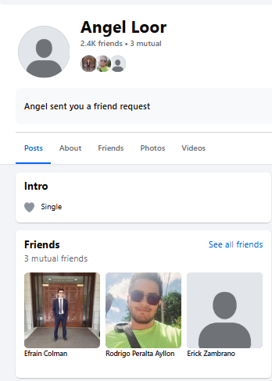
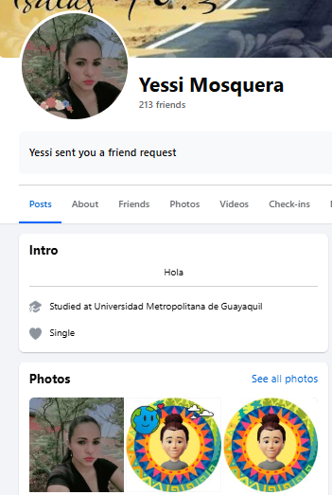
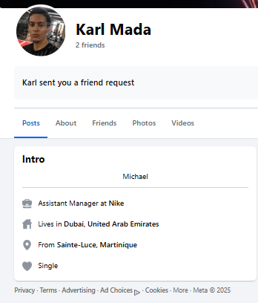
Fake Accounts: (Catfishing)

Slide 16
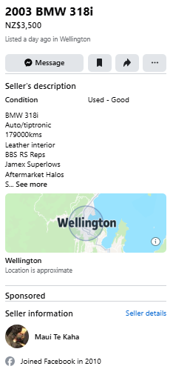
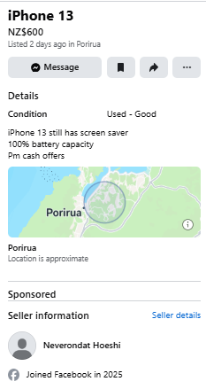
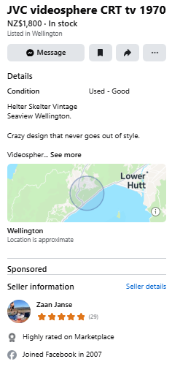
Fake Accounts: (Catfishing)

Slide 17
Mine Sweeper: Go onto your friend requests, friends, or suggested friends and find and share Red Flags
Activity

Slide 18
Other ways to Verify:
Cross Reference: Does this account have links to other accounts on different platforms?
Verification Badges: Most websites or Social Media Platforms have a verification badge to verify legitimate users. (LinkedIn)
Multiple Accounts: Check if there are multiple accounts with the same details, one may be old or hacked.
Confirm with a Person: If you are still unsure whether or not someone is using a fake account confirm in person with owner or mutual.
Reverse Image Search: Reverse image searching can prove whether or not a photo is being reused or is authentic.
Security check details: Enter profile details on websites like “HaveIBeenPwned” to show scam reports
Comments/Reviews: See comments or reviews of other products to profile. Identify fake reviews too.
https://www.consumerprotection.govt.nz/general-help/scamwatch/identify-a-scam#how-to-check-for-scams

Slide 19
What other methods are there to ensure secure payments?
Purchases

Slide 20
Secure Payment Methods:
In Person – Cash: Safe if you can verify product is in working condition. No risk of online scams. Best used in safe, public areas.
Official Payment Systems (AfterPay, Ping, etc): Offer buyer protection and tracks transactions through platform.
Credit Cards – In most cases, if some is a victim of fraudulent behaviour they can receive a cash back where money paid into an account is reversed back into the purchasers.
Bank Transfer: Unlike credit cards, bank transfers do not offer charge backs. Transfers are treated differently and therefore cannot be returned, even if scammed. Avoid. (Rare Case with Andrew Che and $158,000)

Slide 21
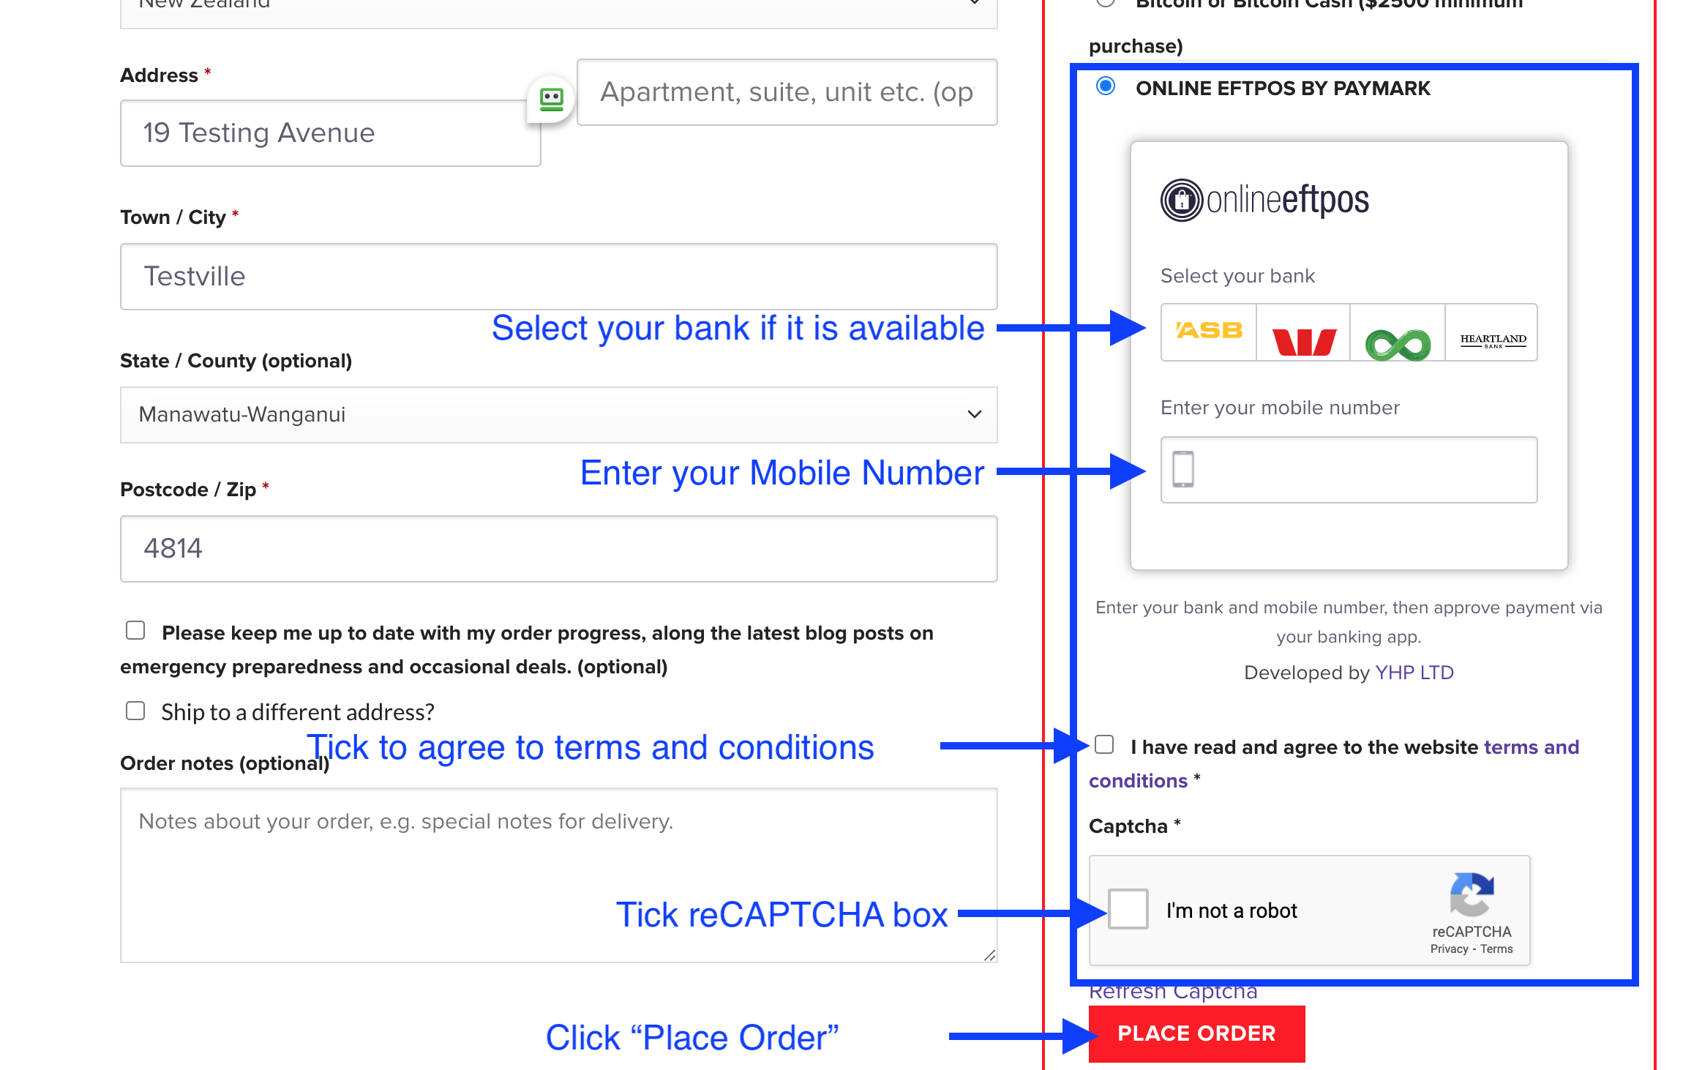
Online Payments Secure Examples:

Slide 22
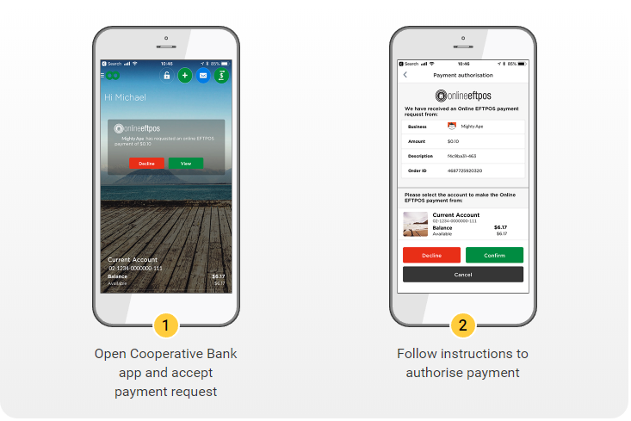
Online Payments Secure Examples:

Slide 23
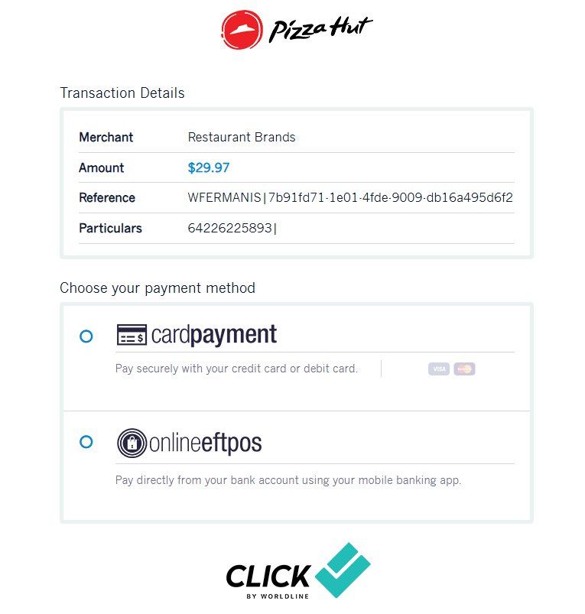
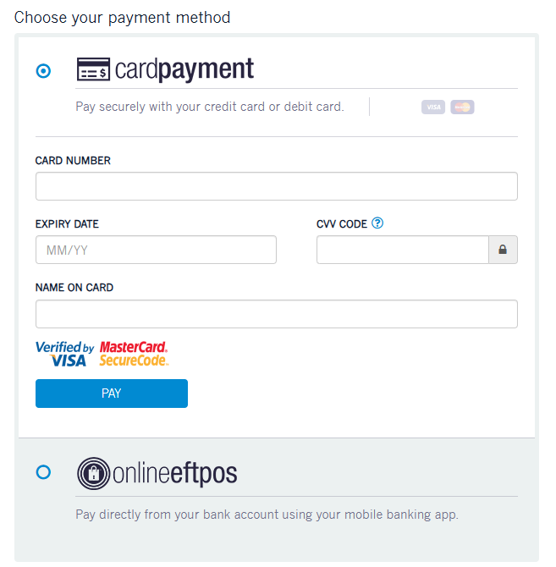
Online Payments Secure Examples:

Slide 24
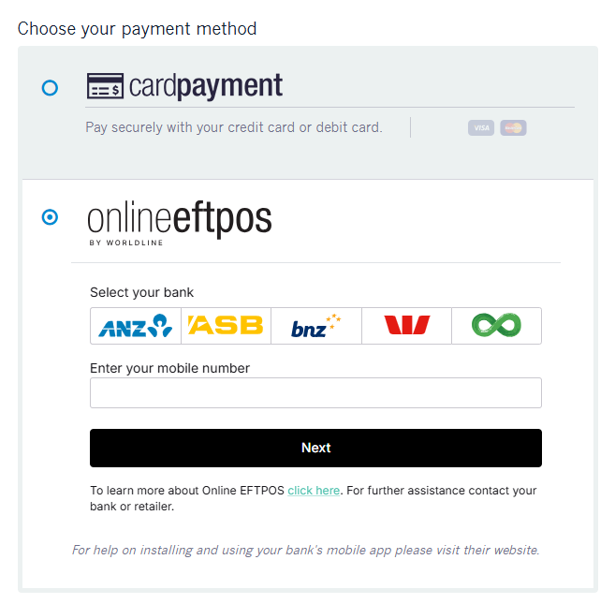
Online Payments Secure Examples:

Slide 25
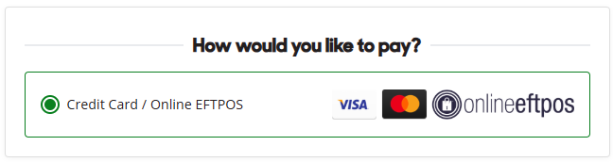
Online Payments Secure Examples:
Notes:
Starts from the Dominoes Pizza Website
Redirects us to a secure third party website that specialises in processing payment information
Both are secured via https and share legitimate URLs

Slide 26
Secure Selling Methods:
In Person – Cash: Safe, can view cash before delivering products or services.
Bank Transfer: Once cleared, it is hard to reverse funds that are confirmed into your account.
Official Payment Systems (AfterPay, Ping, etc): Offers both buyer and seller protection throughout transaction. (This includes credit cards for most sales made)
Crypto/Stocks: Highly volatile
Email confirmations: Always double check legitimate payment process

Slide 27
Managing and reviewing subscriptions
Subscriptions

Slide 28
Where to find and review outgoing subscriptions
App Stores Review
Review active subscriptions through app store accounts on mobile devices to monitor charges.
Bank Statements Check
Examine bank and credit card statements regularly to identify recurring subscription charges.
Account Settings Review
Access platform account settings to find and manage current subscription services effectively.
Notes:
Starts from the Dominoes Pizza Website
Redirects us to a secure third party website that specialises in processing payment information
Both are secured via https and share legitimate URLs

Slide 29
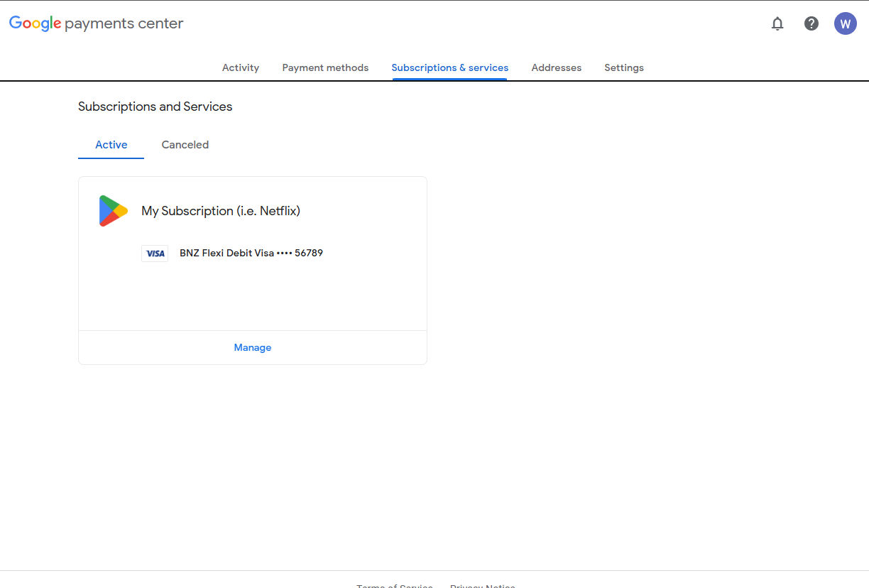
Google

Slide 30
How to cancel unwanted or unknown subscriptions
Using Platform Settings
Access account settings on platforms to review and cancel unwanted subscriptions easily.
Contacting Service Providers
Reach out directly to service providers to request cancellation of unknown or unwanted subscriptions.
Confirming Cancellation
Always follow up to verify subscription cancellations to avoid future charges.
Notes:
Starts from the Dominoes Pizza Website
Redirects us to a secure third party website that specialises in processing payment information
Both are secured via https and share legitimate URLs

Slide 31
Tips for keeping track of ongoing payments
Review Bank Statements
Regularly check bank statements to identify all ongoing payments and subscriptions accurately.
Set Payment Reminders
Use calendar or phone reminders to keep track of payment due dates and avoid missed payments.
Use Budgeting Apps
Leverage budgeting apps to track subscriptions and manage ongoing payments efficiently.
Notes:
Starts from the Dominoes Pizza Website
Redirects us to a secure third party website that specialises in processing payment information
Both are secured via https and share legitimate URLs

Slide 32
Assignments:
Assignment 1: Remove or delete friend requests or friend suggestions from accounts with Red Flags
Assignment 2: If applicable, review monthly subscriptions. (Even if you are not paying for them)

Slide 33
Conclusion: What we covered
Identifying Scams and Fraudulent Activities Online
Spotting and Avoiding Fake Profiles
Assessing Online Authenticity and Trustworthiness
Safe Practices When Buying/Selling Online
Managing and Monitoring Online Subscriptions

Slide 34
Activities:
Interland by Google – “Reality River”
Topic: Online deception, fake messages/profiles.
Game: Choose the trustworthy answer to progress.
Why it fits: Covers fake info and scams in a fun format.
Assignments:
- Assignment 1: Remove or delete friend requests or friend suggestions from accounts with Red Flags
- Assignment 2: If applicable, review monthly subscriptions. (Even if you are not paying for them.

Slide 35
https://www.scamwatch.gov.au/types-of-scams
Sources/More Info

